Slide 1
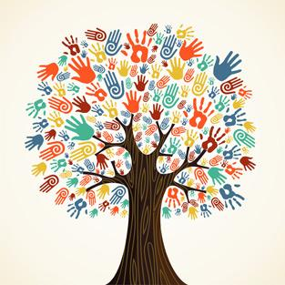
Between The Lines: Small ways Minority Culture Can be Integrated into CA High School Curriculum
CLP 2014
Jonathan Ho
Russell Hong
Albert Lutz-Paap
Linh Ton
Thy Truong

Slide 2
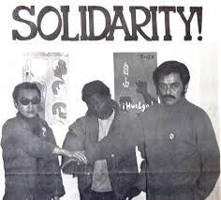
The Birth of Ethnic Studies
-Third World Liberation Front (twLF) SFSU, UCB 1969
-Minority student group history undervalued & ignored.
Notes:
Albert

Slide 3
Resistance
Mainstream Curriculum
Heroes and Holidays
Integration
STRUCTURAL REFORM
Balancing Priorities
Culturally Competent Teachers
Inclusion (Include All Cultures)
Cultivate Difference
Acknowledge Difference
Notes:
Jonathan

Slide 4
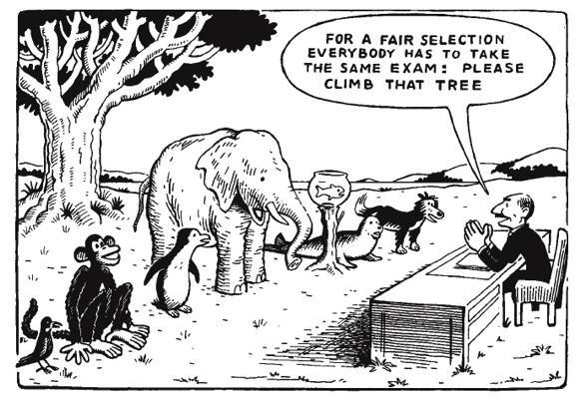
What’s Common Core ?
Pros
- International standards.
- Critical thinking skills.
Cons
- Difficult transition.
- Vague standards.
Notes:
Russell

Slide 5
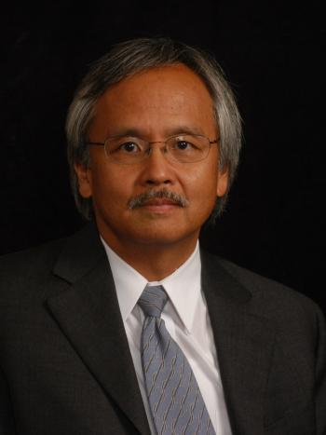
What the experts say (Action Plan)
Work within Common Core; lots of room for Inclusive Curriculum.
Supplemental multicultural reading list.
Gary Mukai, Director of the Stanford Program for International and Cross-Cultural Education (SPICE)
Notes:
Russell

Slide 6
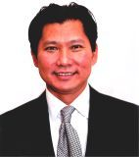
Opportunity
-East Side reamping curriculum
-Opportunity in Elective Classes.
(Hispanic-46%,
Asian- 32%).
-Awareness: Film “Precious Knowledge”
-HB 2281- Banned Ethnic Studies
Lan Nguyen: Board of Trustees member, East Side Union High School District
Notes:
Thy
insights:

Slide 7
Hope for Ethnic Studies
-California Assembly Bill 1750: “Bill to Promote Ethnic Studies in Public Schools”
-Would not immediately mandate a standardized Ethnic Studies curricula
-Invest $125,000 in bringing together experts to develop inclusive curricula

Slide 8
San Francisco Unified School District
-Who they are
-Adopting a resolution to support Ethnic Studies in their schools
-Implementing Ethnic Studies across CA

